Slide 1
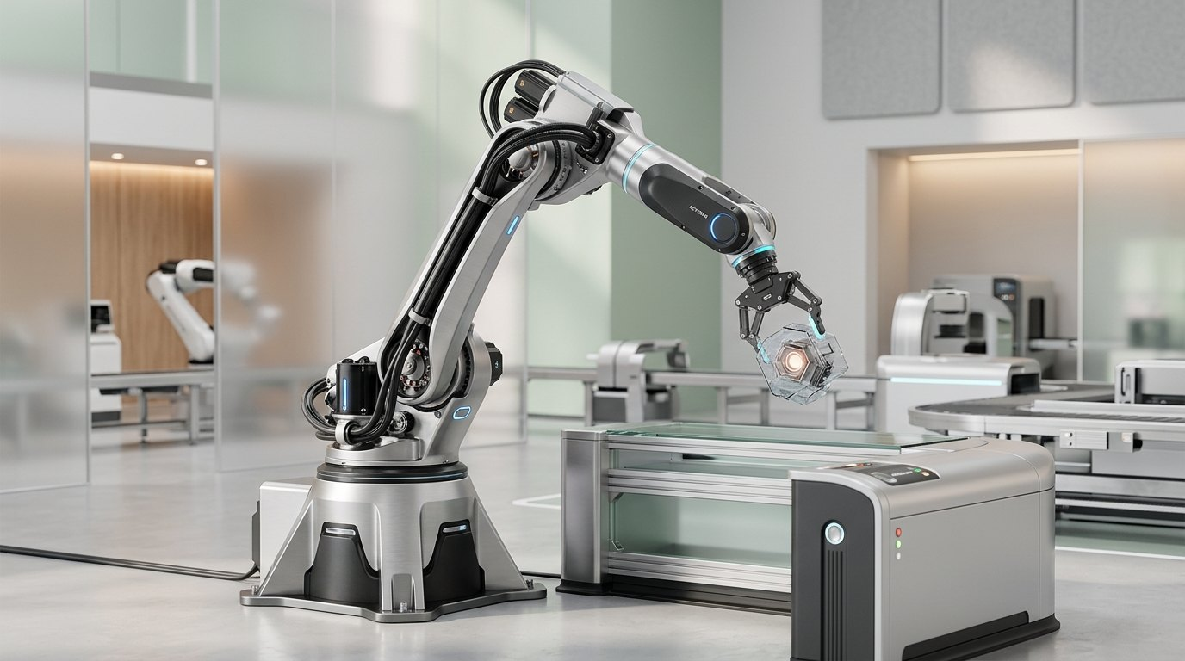
Q4 2025 EARNINGS
Halden Robotics: Scaling Global Warehouse Automation
February 2026 | Ticker: HALD
01

Slide 2

Representing 31% year-over-year growth in core markets
$84.2M
Q4 QUARTERLY REVENUE
02
Notes:
Our top-line growth reflects the successful onboarding of major enterprise accounts. This $84.2M figure surpasses our previous guidance and sets a new quarterly record.

Slide 3
FY 2025 Financial Highlights
$287M
Annual Total Revenue
44.1%
Gross Margin (+320bps)
$6.1M
Positive EBITDA
$142M
Cash on Hand
03
Notes:
FY25 marks our first-ever EBITDA positive year. We managed to expand margins by 320 basis points while maintaining a robust cash position for future R&D.

Slide 4

Operations
Operational Milestones
04
Notes:
Transitioning to our operational review, focusing on fleet expansion and industry-leading reliability metrics.

Slide 5
Quarterly Revenue Growth
Revenue in USD Millions (FY 2025)
05
Notes:
Notice the acceleration in Q4. Peak holiday season demand drove higher utilization and additional robot-as-a-service (RaaS) subscriptions.

Slide 6
Global Deployment Footprint
◆ 1,847 robots actively deployed
◆ Operational in 94 facilities worldwide
◆ Industry-leading 2.1% churn rate
06
Notes:
Our footprint now spans 94 facilities. The low churn rate is a testament to the reliability of our hardware and the deep integration of our software.

Slide 7



Customer Momentum & Retention
127% NRR
Net Revenue Retention driven by site expansions
New Logos
Onboarded DHL and Carrefour this quarter
$410M Backlog
Total contract value up 58% YoY
07
Notes:
Our 'land-and-expand' strategy is working. Most clients start with one facility and expand to five or more within 18 months.

Slide 8
Innovation
Profitability & R&D
08
Notes:
A look at how our shift toward software-led automation is driving our path to sustained margin expansion.

Slide 9
Margin Bridge: Efficiency Gains
FY 2024
• 40.9% Gross Margin
• Hardware-heavy mix
• Negative EBITDA
• Manual error recovery
FY 2025
✓ 44.1% Gross Margin
✓ Software-mix shift
✓ Positive EBITDA ($6.1M)
✓ Optimized supply chain
09
Notes:
The 320bps improvement is largely due to our software-mix shift and supply chain optimization. We are now seeing the scale benefits of our manufacturing partnerships.

Slide 10
R&D Focus: Foundation Models
1
2
3
Vision
Transitioning to vision-based autonomy
Learning
Implementing zero-shot learning models
Recovery
Automating complex error recovery
10
Notes:
We are investing $52M in AI. This move from rule-based to vision-based picking will drastically reduce deployment times.

Slide 11
2026 Guidance & Outlook
Metric | 2025 Actual | 2026 Target
Revenue | $287M | $380M - $405M
Fleet Size | 1,847 | 2,900 Units
EBITDA Margin | 2.1% | 4% - 6%
New Markets | Global | Japan & Brazil
Projected growth based on current backlog
11
Notes:
Our 2026 guidance assumes a 35% growth at the midpoint. We are specifically targeting entry into Japan and Brazil to capture untapped logistics demand.

Slide 12
2026 Strategic Roadmap
1
2
3
4
Q1
Launch Brazil operational hub
Q2
Release Vision-Foundation Model
Q3
Japan market entry and Tokyo DC
Q4
Scale to 3,000 unit run-rate
12
Notes:
Key catalysts for 2026 include the general availability of our AI Vision model and our expansion into the Asian market via Tokyo.

Slide 13

Halden Robotics has reached a critical inflection point. EBITDA positivity validates our unit economics and the essential nature of warehouse automation.
“
— CEO, Halden Robotics
13
Notes:
Closing thoughts from leadership emphasizing that the business model is now proven and ready for aggressive global scaling.

Slide 14

THANK YOU
Investor Relations
investors.haldenrobotics.com | Q&A Session
14

Slide 15
AIM DECK
Made with AIM DECK · aim-deck.ai

